Slide 1
FILTERS

Slide 2
Objectives
Introduction to Filter
Filter life cycle
FilterChain
Programming Filter
  Create filter
  Declaring and Mapping Filter
Modify Request and Response
<number>/41

Slide 3
What is Filter?
Filters are pluggable java components that used to intercept and process requests before sending it to servlets and response after servlet code is finished and before container sends the response back to client.
Filter can be attached to one or more servlets or JSP pages and can examine the request information going into these resources.
Filter can Invoke the resource in normal manner.
Filter can Invoke the resource with modified request information and modify response before sending it to the client.
Filter can prevent resource from being invoked and redirect to a different resource, return status code, or generate replacement output.
A filter provide universal functions that can be "attached" to any type of servlet or JSP page
<number>/41

Slide 4
What filter can be used for ?
Authentication-Blocking requests based on user identity.
Logging and auditing-Tracking users of a web application.
Image conversion-scaling maps, and so on.(JAI or ImageJ)
Data compression-Making downloads smaller.
Localization-Targeting the request and response to a particular locale.
XSL/T transformations of XML content-Targeting web application responses to more than one type of client.
encryption, tokenizing, triggering resource access events
..
<number>/41

Slide 5
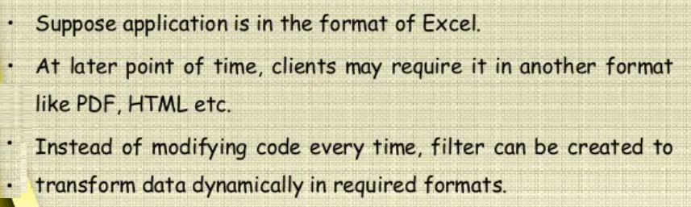
Example uses of filter
Tracking whether user has login?
Transformation data format
<number>/41

Slide 6
Filter programing
The filter API is defined 3 interfaces
  Filter
  FilterChain: used to invoke the next filter in the chain
  FilterConfig: provide init parameters and servlet context object to the Filter
Filter interface lifecycle methods are:
  init(filterConfig)
  doFilter(request, response, filterChain)
  destroy()
<number>/41

Slide 7
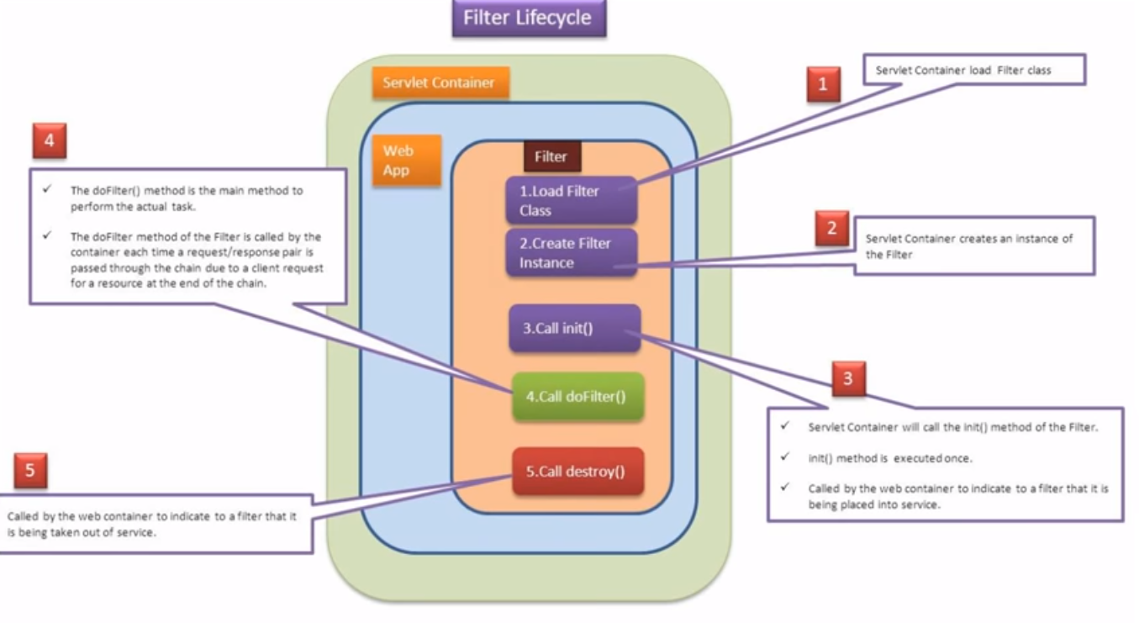
Filter life cycle
<number>/41

Slide 8
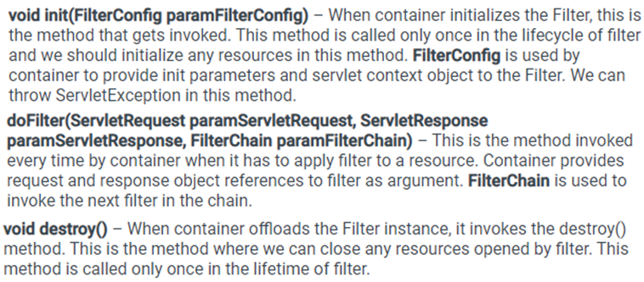
Filter implementation
Define filter by a class that implements Filter
  Put the filtering behavior in the doFilter method
<number>/41

Slide 9
Filter Chain
Multiple filters can be set up to perform pre-processing of requests and responses associated with a servlet. These filters are managed by FilterChain.
Filters use the FilterChain to invoke the next filter in the chain
FilterChain.doFilter() is always called in Filter's doFilter() method to ensure all installed filters are invoked.
If the invoked filter is the last one in the chain, target resource is invoked
<number>/41

Slide 10
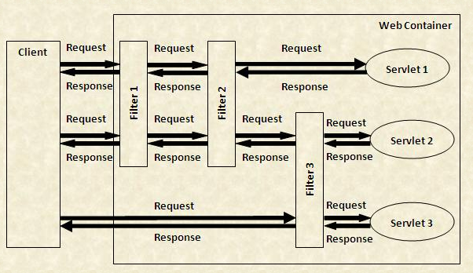
Filter Chain
The order in which these Filters are executed depends on the order of <filter-mapping> tag described in the web.xml file. (no order with annotation!)
<number>/41

Slide 11
Steps to create and declare Filter
Create a class that implements the Filter Interface. [ init, doFilter , destroy ]
Put the filtering behavior in the doFilter(req, res, chain) method. Invoke the chain.doFilter(req,res) method of the FilterChain object.
Register the filter with the appropriate servlets and JSP page.
In Netbean can code 2 methods in generated Filter class
+ doBeforeProcessing(request, response)
+ doAfterProcessing(request, response)
<number>/41

Slide 12
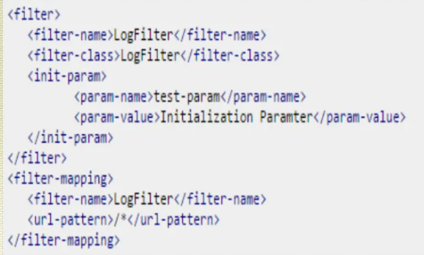
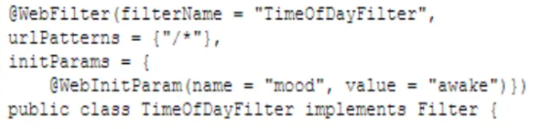
Configuring Filter
Filters can be configure using web.xml or annotation
  Use filter and filter-mapping tags to register filter in servlet.
  Using annotation
<number>/41

Slide 13
Filter and mapping tags
In filter element we can have icon, filter-name, display-name, filter-class, init-param.
In filter-mapping element filter-name, url-pattern, servlet-name, dispatcher.
dispatcher : Optional used to specifies what type of request this filter-mapping should apply to.
Possible values are REQUEST, FORWARD, INCLUDE and ERROR
<number>/41

Slide 14
Request – Response Wrapper
Wrapper classes used to extend the functionality of request or response objects.
  request validation,
  change or add more data to the request before it reaches the requested Servlet,
  change or add more data to the response object.
Steps to create and use wrapper
  Define wrapper class extends API wrapper class
  + override required method
  Creater a wrapper instance over the request/response object
  Include or forward using this wrapper passing it instead of request/response. It should behave exactly as before (without wrappers)
<number>/41

Slide 15
Request – Response Wrapper
Wrapper classes implements the required interfaces – ServletRequest & ServletResponse
Should extend the API wrappers and override only those methods that are required to be changed
  HttpServletRequestWrapper
  HttpServletResponseWrapper
Making any modifications to your custom wrappers to extend or modify the functionality of request or response objects
<number>/41

Slide 16
Wrapper example
public class RequestWrapper extends HttpServletRequestWrapper { public RequestWrapper(HttpServletRequest req) {
super(req);
}
public String getParameter(String param) {
String name = super.getParameter(param);
if( name.equals("")) {
name = "Please, enter your name in the form"; }
return name;
} }
public void doFilter(ServletRequest request, ServletResponse response, FilterChain chain) throws ServletException, IOException{
// do before
RequestWrapper reqWrapper = new RequestWrapper(request);
chain.doFilter(reqWrapper, response);
// do after }
<number>/41

Slide 17

Blocking the Response (1)
What we do in a filter
public void doFilter(ServletRequest request,ServletResponse response, FilterChain chain) throws ServletException, IOException { HttpServletRequest req = (HttpServletRequest)request; context.log(req.getRemoteHost() + " tried to access " + req.getRequestURL() +" on " + new Date() + "."); chain.doFilter(request,response);
}
<number>/41

Slide 18
Blocking the Response (2)
public void doFilter(ServletRequest request,ServletResponse response, FilterChain chain) throws ServletException, IOException { HttpServletRequest req = (HttpServletRequest)request; context.log(req.getRemoteHost() + " tried to access " + req.getRequestURL() +" on " + new Date() + "."); if(condition==true)
response.sendRedirect(“some other page /site”); else
chain.doFilter(request,response);
}
<number>/41

Slide 19
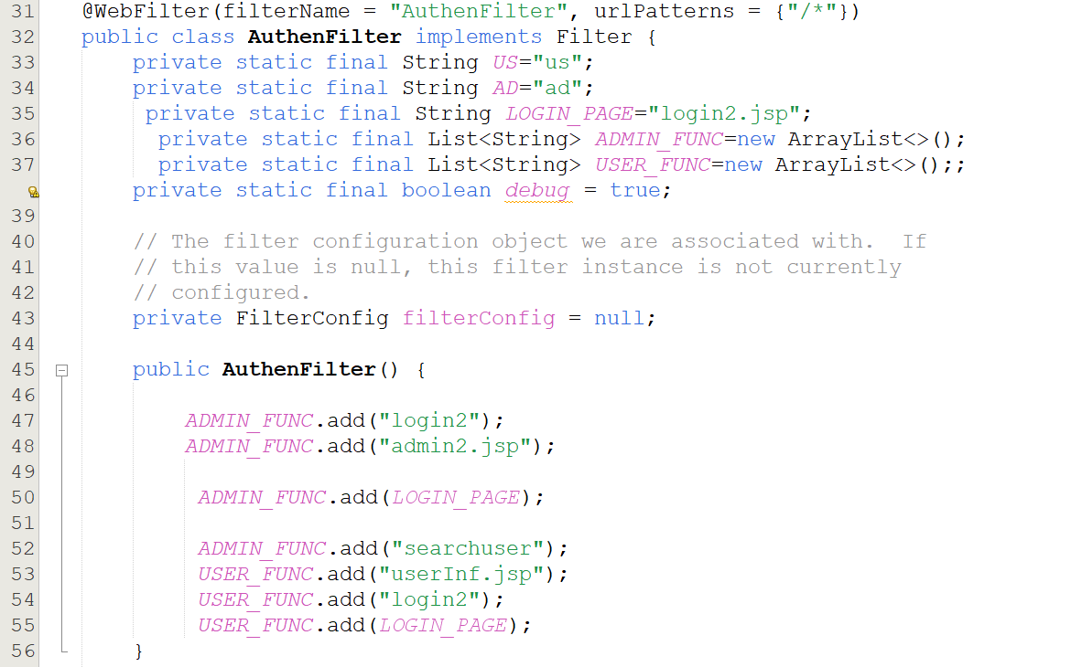
<number>/41

Slide 20
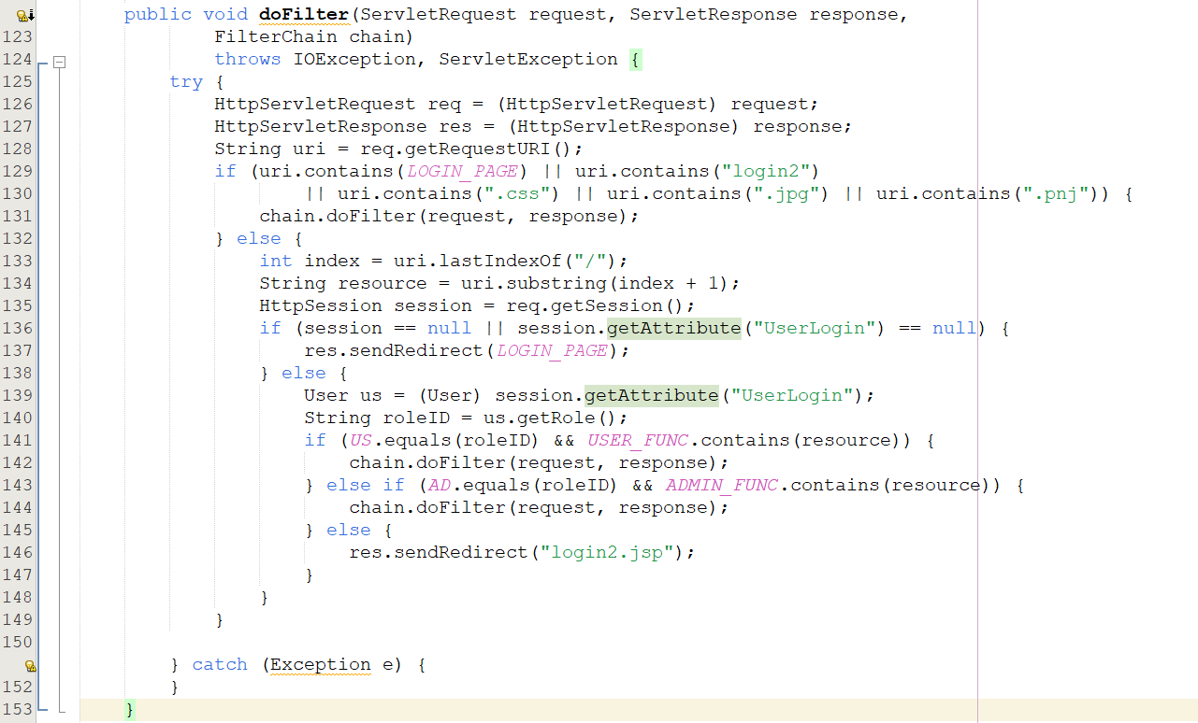
<number>/41

Slide 21
Summary
What’s Filter?
What it can be used for ?
Filter life cycle
Programming Filter
Filter configuration
Filter chain
Request and response wrapper
<number>/41

